Slide 1


Initial analysis and comparison of the wave equation and asymptotic prediction of a receiver experiment at depth for one-way propagating waves
Chao Ma*, Jing Wu and Arthur B. Weglein
M-OSRP 2014 Annual Meeting, May, 2014
Austin, TX
Notes:
1
1

Slide 2



Motivation
Qiang et al (2014) examine the amplitude information at the image that derives from a wave equation migration algorithm and its corresponding asymptotic form.
The asymptotic form follows from a stationary phase approximation performed on the operator that predicts the receiver and source experiment at depth.
We examine the prediction of the receiver experiment at depth:
  Green’s theorem/FK prediction
  The exact Cagniard-deHoop (CdH) solution
  The asymptotic output.
Notes:
In the previous presentation, the relationship between a wave equation migration algorithm

Slide 3
Outline
Theory
    Wave equation prediction and its corresponding asymptotic form for one way waves
Numerical test
Summary

Slide 4
Wave equation prediction for one way up-going waves
Stolt (1978), Stolt and Benson (1986), Stolt and Weglein (2012)
Assuming an up-going wave, and homogeneous medium

Slide 5
Asymptotic form of the wave equation prediction for one way up-going waves

Slide 6
Asymptotic form of the wave equation prediction for one way up-going waves

Slide 7
Asymptotic form of the wave equation prediction for one way up-going waves

Slide 8
Asymptotic form of the wave equation prediction for one way up-going waves
Non-linear
Linear

Slide 9
Outline
Theory
    Wave equation prediction and its corresponding asymptotic form for one way waves;
Numerical test
Summary

Slide 10
Numerical test comparing a wave equation prediction of a receiver experiment at depth and its asymptotic form
Model:
-20,000 m to 20,000 m (dx=4m)
Input data at depth 400 m
Reflector depth 2000 m
Tmax=5 s, dt=1 ms;

Slide 11
Numerical test comparing a wave equation prediction of a receiver experiment at depth and its asymptotic form
Input data at depth 400 m
Predicted depth 600 m
Reflector depth 2000 m
Input | Calculate

Slide 12
Numerical test comparing a wave equation prediction of a receiver experiment at depth and its asymptotic form
Comparison
(0m offset and 2000m offset)

Slide 13
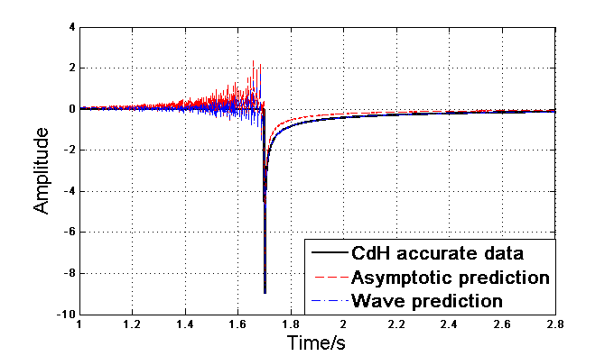
Compare (0 m)
Zero-offset space-time

Slide 14
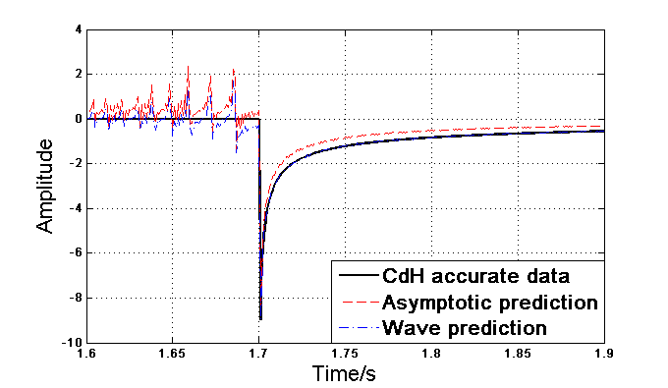
Compare (0 m)
Zero-offset space-time
(zoom-in of the plot in the last slide)

Slide 15
Compare (0 m)
Zero-offset space-frequency

Slide 16
Compare (0 m)
Zero-offset space-frequency
(zoom-in of the plot in the last slide)

Slide 17
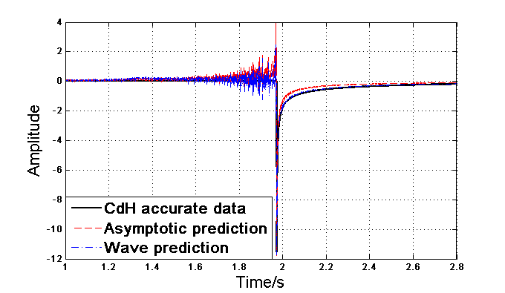
Compare (2000 m)
2000 m-offset space-time

Slide 18
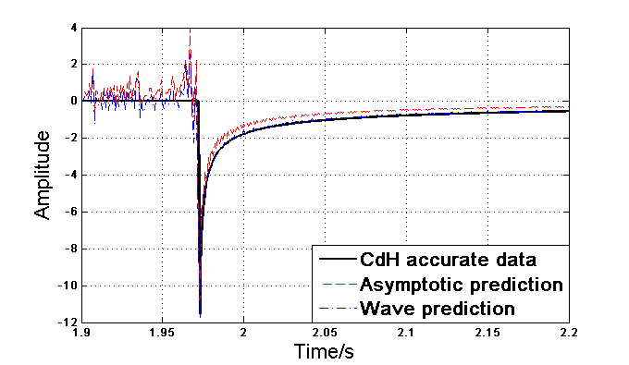
Compare (2000 m)
2000 m-offset space-time
(zoom-in of the plot in the last slide)

Slide 19
Compare (2000 m)
2000 m-offset space-frequency
(zoom-in of the plot in the last slide)

Slide 20
Compare (2000 m)
2000 m-offset space-frequency
(zoom-in of the plot in the last slide)

Slide 21
Outline
Theory
    Wave equation prediction and its corresponding asymptotic form for one way waves;
Numerical test
Summary

Slide 22
Summary
The difference in the spectrum at the low end has a dramatic impact on subsequent imaging step, and makes the asymptotic migration method NOT an approximate source and receiver coincident experiment at time equals zero.

Slide 23


